Slide 1

MLB Expansion
An analysis for the possibility of an expansion team in the United States for Major League Baseball
GIS 101: Intro to GIS
Justin Wells

Slide 2
What is an Expansion Team?
A new franchise added to a professional sports league.
Typically established to help grow the league in a variety of ways.
Often created in response to market demand or to balance the number of teams in a league.
Intend to bring excitement and opportunities for new players, coaches, and fans to engage with the sport.

Slide 3
Why would the MLB want to expand?
Market Growth: expanding to new cities can increase MLB's overall fan base and revenue potential
Increased Competition: more teams → more competition, leads to more excitement, better games, and increased viewership
Economic Benefits: job creation, increased tourism, and local business opportunities
Global Expansion: attract fans from different countries and cultures
Fan Engagement: reignite fan interest and engagement, both existing and new
TV and Media Deals: increase in broadcasting revenue and exposure for the MLB

Slide 4
Research Question
Which cities or towns possess the optimal combination of population demographics, economic stability, existing sports culture, and infrastructure to support the successful establishment of an MLB expansion team?

Slide 5
Project Motivation/Plan
Conduct a search to identify potential cities or towns suitable for expansion teams/organizations
Explore the relationships between infrastructure, economics, sports culture, and demography
Deliver insights through thorough research and geographical analysis
Use data-driven analysis to identify new cities for baseball expansion or team relocation

Slide 6
Data Sources
ArcGIS Online
transit and infrastructural data
Homeland Infrastructure Foundation - Level Data (HIFLD)
existing sports venues in the US
Census.gov: American Community Survey (ACS)
Economic: household income
Population: percentage of dependants in population

Slide 7
Methods
Pinpoint 5 potential cities suitable for hosting an expansion team
Nashville, TN, Charlotte, NC, Salt Lake City, UT, Portland, OR, and Sacramento, CA
Use select by locations and select by attributes to narrow down the economic and population data to those 5 specific cities and their surrounding areas
Spatial join all of the transit and infrastructure data found for each city to get a visual representation of travel in each respective region

Slide 8
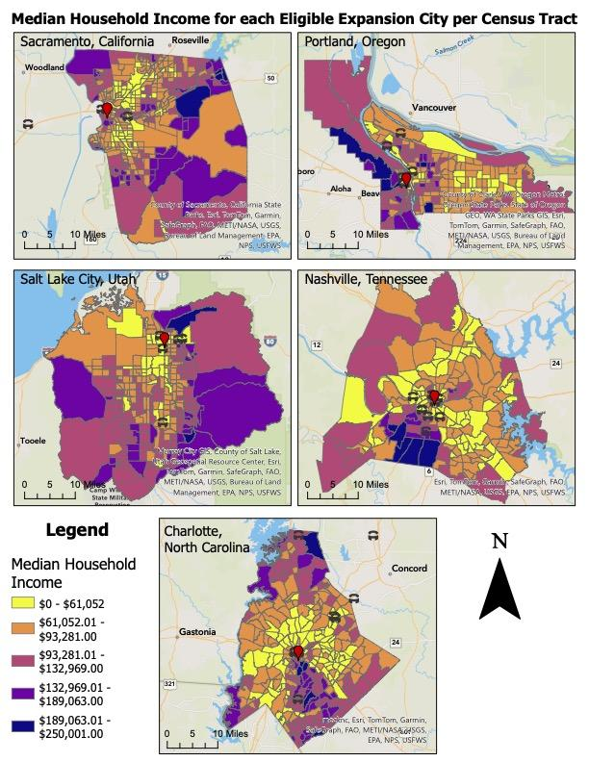
Preliminary Findings
Median Household Income Data
Map displays each county of the 5 cities focused on in the project

Slide 9
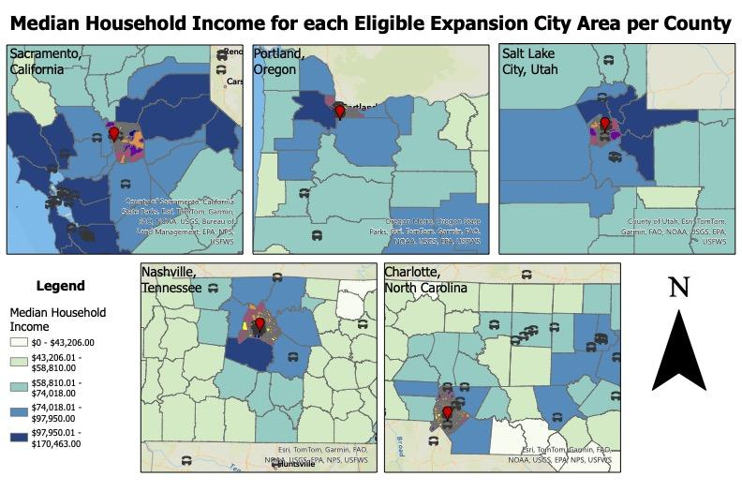
Preliminary Findings

Slide 10
Future Work (needed to finish project)
Population Variables
Need to finish narrowing down the boundaries for two more of the cities
Finish analysis for all of the cities as well as create maps (similar to those just displayed)
Infrastructure/Transit
Cities like Portland have been tougher to find data for
Need to finish spatial joins and analysis for the transit data for each respective city
Tourism
Less geographical analysis and use of GIS
Still important aspect of determining city right for expansion

Slide 11
QUESTIONS?

